Slide 1
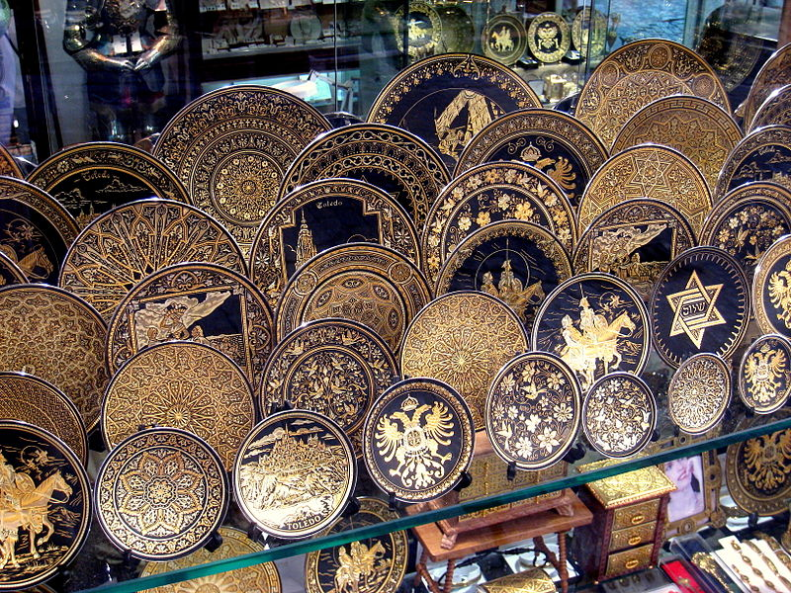

Lecture 13
Chemical Engineering for Micro/Nano Fabrication
Damascene

Slide 2
Reverse Tone Etch Process: “S-FIL/R”
(Lower aspect ratio features, thick residual layer, topography)
Planarizing overcoat
(High Si content)
Low aspect ratio imprint
thick residual layer of organic material
SUBSTRATE
Si material after blanket etch back or CMP
Advantages of SFIL-R
faster fill
tone reversal
Organic material
SUBSTRATE
Selective and anisotropic O₂ RIE
High aspect ratio pattern
after selective etch
SUBSTRATE

Slide 3






Canon, Toshiba and SK hynix going forward with SFIL
Revolutionizing the Semiconductor Industry - Nanoimprint Lithography
Report: Toshiba adopts imprint litho for NAND production
June 07, 2016 // By Peter Clarke
Toshiba will adopt nanoimprint lithography (NIL) as a way of reducing the cost of production of NAND flash memory, according to a Nikkei report. Toshiba plans to allocate part of an 860 billion yen (about $8 billion) budget for spending on semiconductors over the next three years on introducing NIL into flash memory production lines, the report said. Production is set to begin in fiscal 2017 in Yokkaichi.

Slide 4
News Release
Canon provides nanoimprint lithography manufacturing equipment to Toshiba Memory's Yokkaichi Operations plant
TOKYO, July 20, 2017—Canon Inc. announced today that the company has provided the FPA-1200NZ2C, semiconductor lithography equipment that utilizes nanoimprint lithography (NIL) technology which Canon has been continuously developing since 2004, to leading provider of semiconductor memory solutions Toshiba Memory Corporation's Yokkaichi Operations plant. The provision of this equipment represents significant progress toward semiconductor device mass production that employs nanoimprint technology.

Slide 5
What Happened To Nanoimprint Litho?
Next-gen lithography technology resurfaces for a variety of tasks.
MARCH 29TH, 2018 - BY: MARK LAPEDUS
Nanoimprint lithography (NIL) is re-emerging amid an explosion of new applications in the market……….. Toshiba installed Canon’s latest NIL system in a fab in Japan. If all goes well, Toshiba plans to use Canon’s system to pattern some of the features for its 3D NAND devices, as well as next-generation memory types in the future. Production is slated for later this year. “We hope nanoimprint will be ready for production soon,” said Tatsuhiko Higashiki, senior fellow
https://semiengineering.com/what-happened-to-nanoimprint-litho/

Slide 6
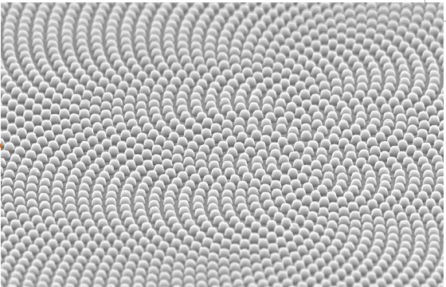
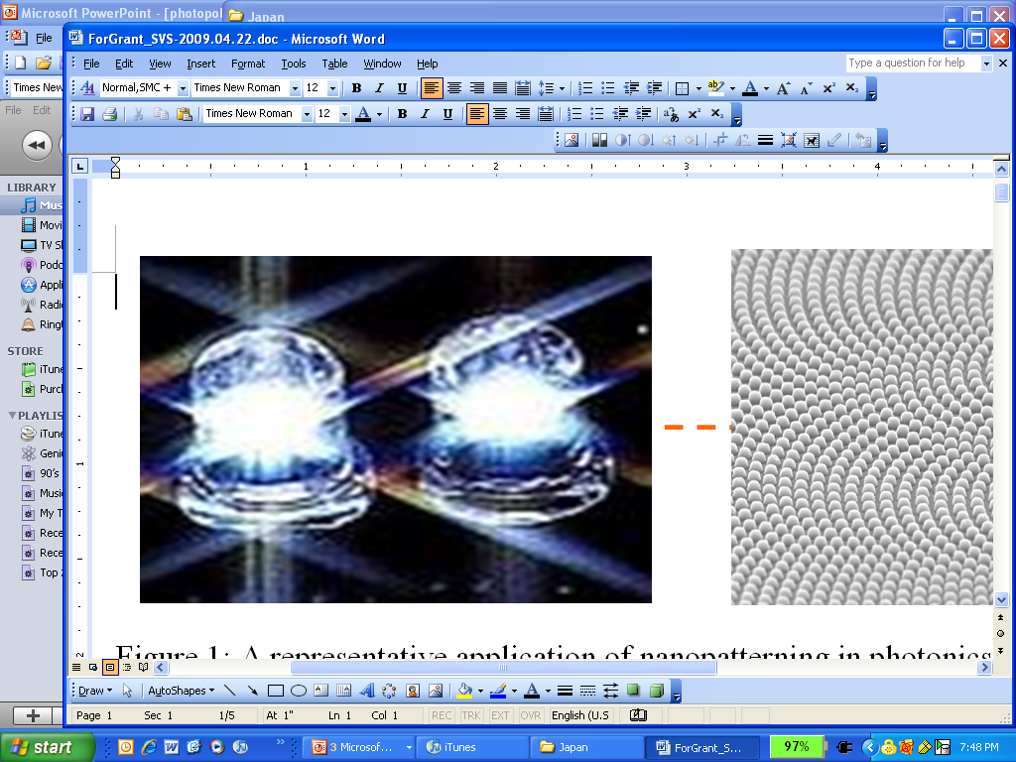


Non-CMOS Applications
100nm
20 nm
100 nm
Patterned
Media
Photonic Crystals

Slide 7



Damascus Syria

Slide 8
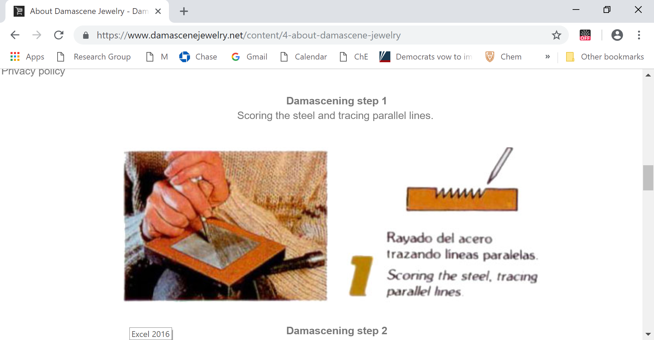
The Damascene Process
https://www.damascenejewelry.net/content/4-about-damascene-jewelry

Slide 9
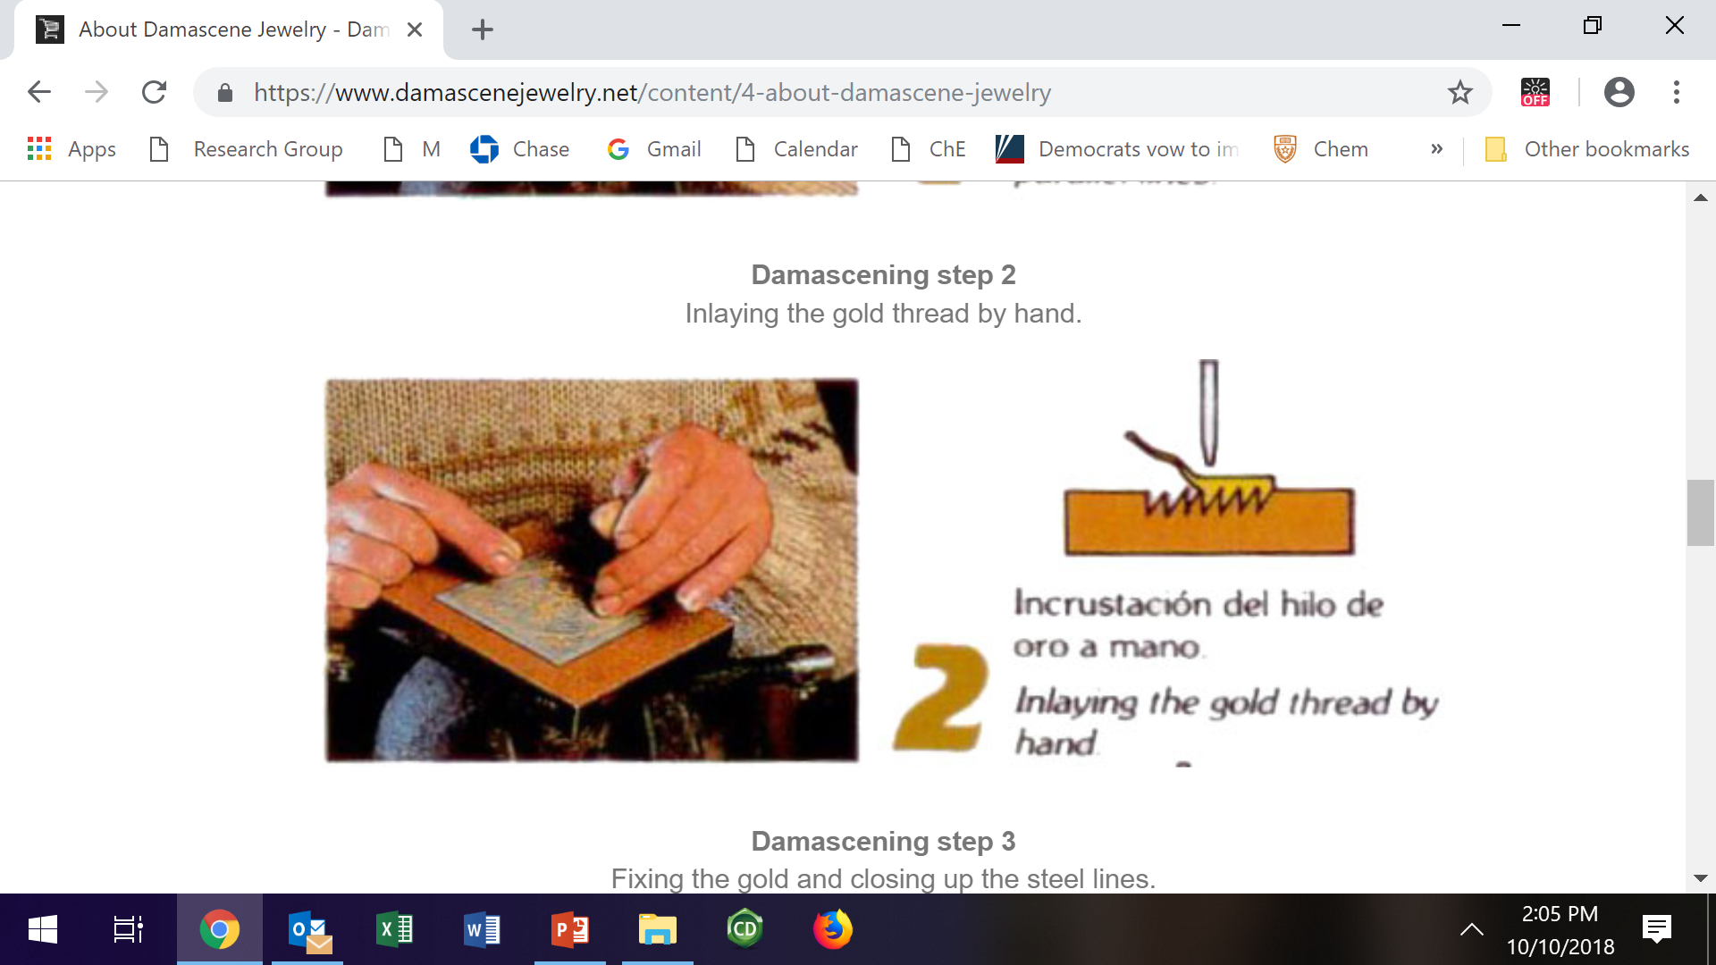
The Damascene Process

Slide 10
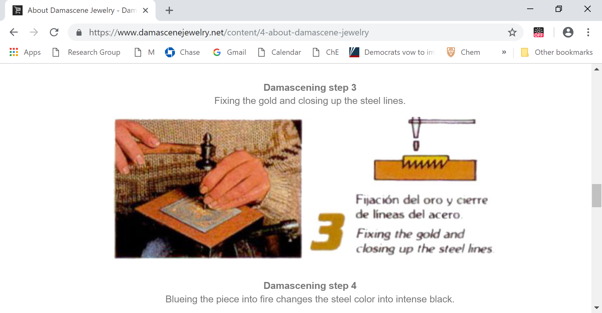
The Damascene Process

Slide 11
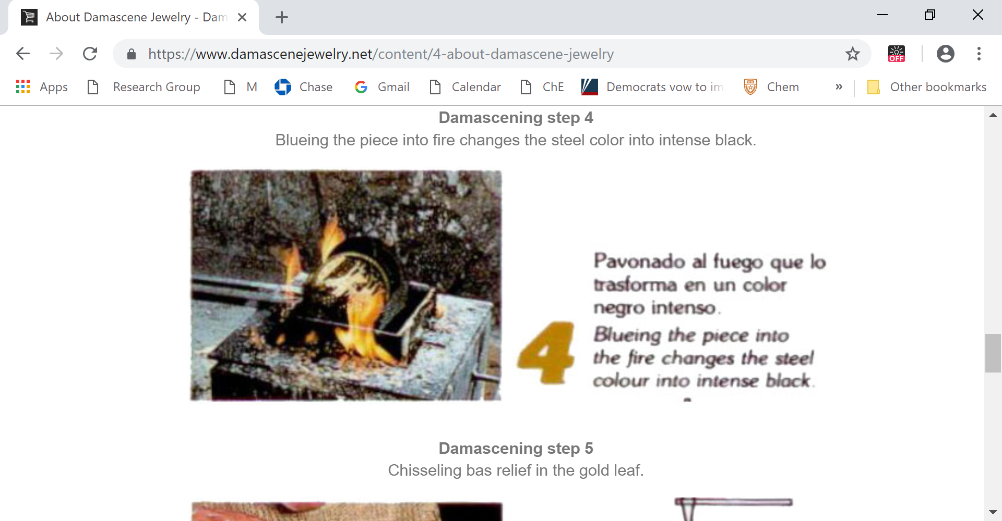
The Damascene Process

Slide 12
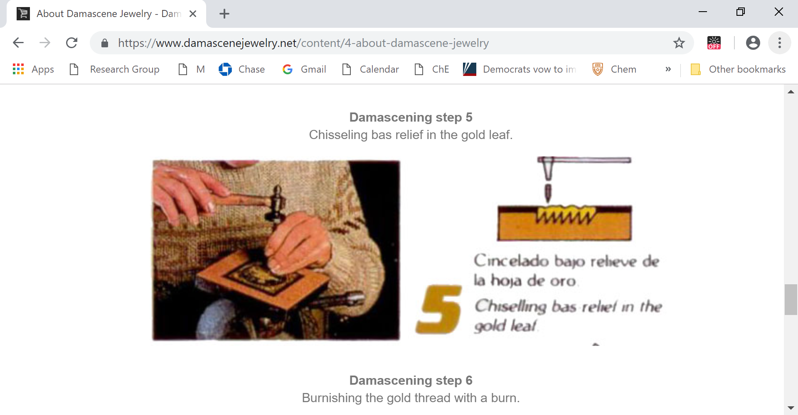
The Damascene Process

Slide 13
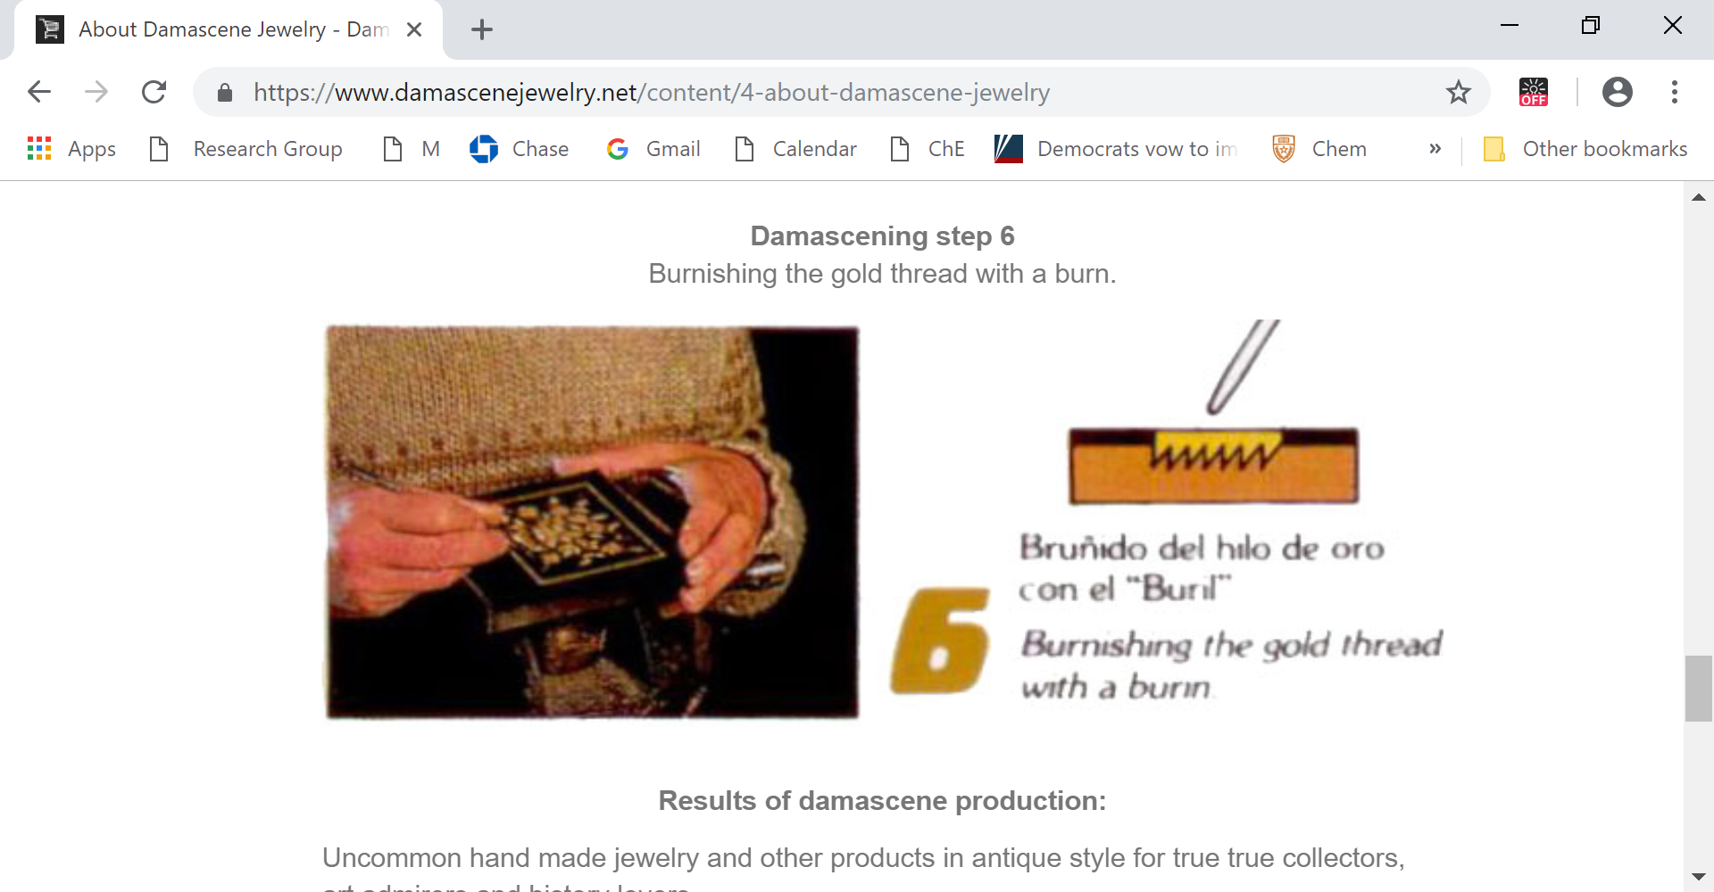
Damascene Process

Slide 14
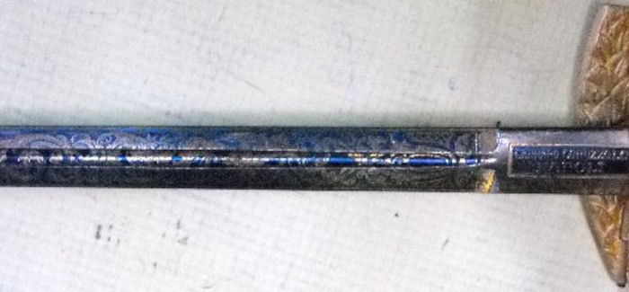
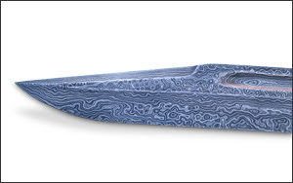
Damascene Swords and Jewelry

Slide 15
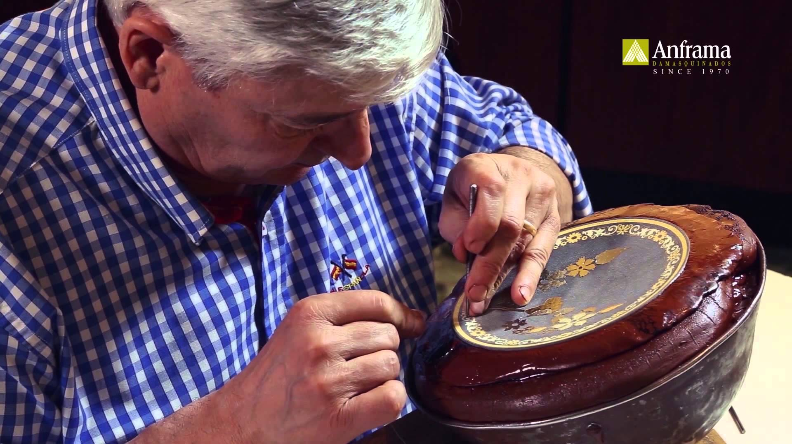
Damascene Swords and Jewelry
https://www.youtube.com/watch?v=mgP2ENTwwTE

Slide 16
Damascene Swords and Jewelry

Slide 17
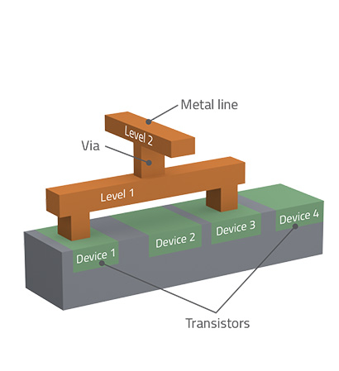
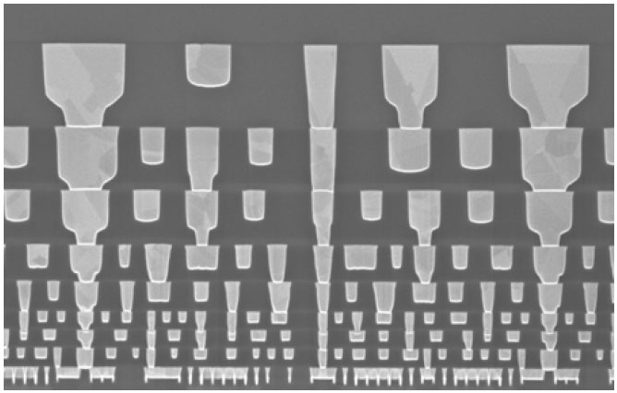
Interconnect levels
“back end of the line”…BEOL

Slide 18
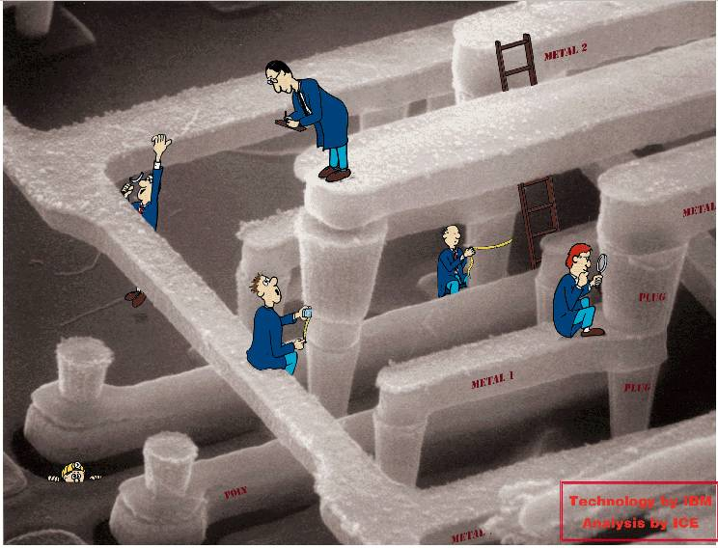
These structures are made by “damascene”. Can we make them more efficiently and at lower cost by SFIL???
Moore
You?

Slide 19

Dual Damascene Process
Traditional
Dual Damascene Process
Dual Damascene Process
with Imprint Litho
ILD = inter layer dielectric
resist
dielectric precursor
ILD
etch stop
etch stop
ILD
substrate
substrate
Initial stack
Initial stack
Trench litho
Trench etch
Imprint
Via litho
BARC / resist
Resist ash
Barrier
Cu metal
CMP
Breakthru etch
Barrier
Cu metal
CMP
Via etch
Resist Ash
Cure
184 steps for 8 levels of Cu
72 steps for 8 levels

Slide 20
SFIL Damascene Process (SIM)
Multi-Tier Template
3
2
# of process steps:
1
SFIL IMPRINTING
Dispense SIM Material
Position template
Flash
Release
CVD Dielectric
Deposit CVD dielectric (BD)
Deposit barrier
M1

Slide 21
SFIL Damascene Process
Etch Transfer
0
4
# of process steps:
5
Sacrificial Imprint Material (SIM)
Strip (SIM)
CVD Dielectric
M1

Slide 22
SFIL Damascene Process
7
8
9
# of process steps:
6
x 8
72
184 – 72 = 112
Saved steps ?
CMP
Copper Plate
Copper Seed
Etch Diffusion Barrier
M1

Slide 23
BEOL Multilevel Imprint Cost Saving
20%
20% overall saving at 30 wph
Cost analysis courtesy of Sergei V. Postnikov, Infineon Technologies

Slide 24
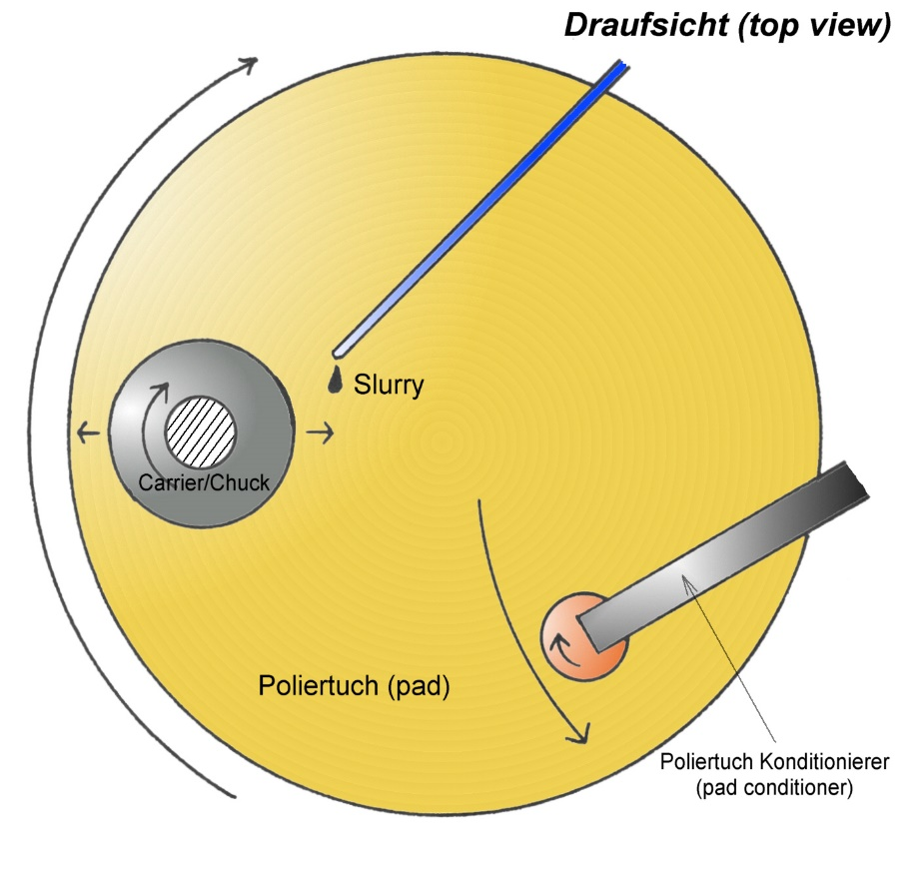
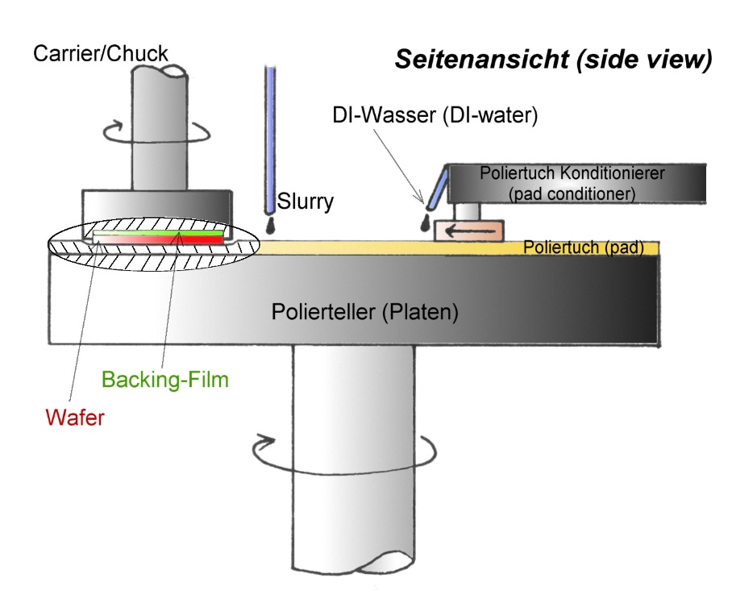
Chemical Mechanical Polishing

Slide 25
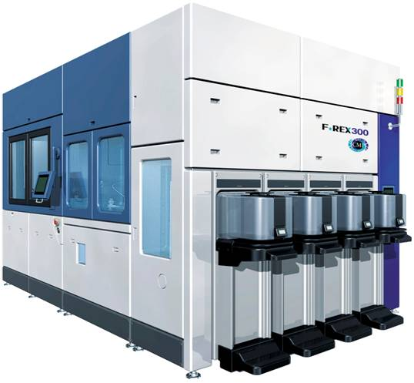
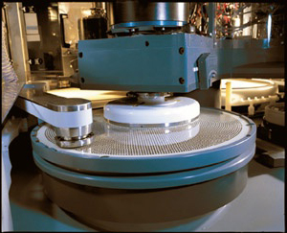
CMP Tools

Slide 26
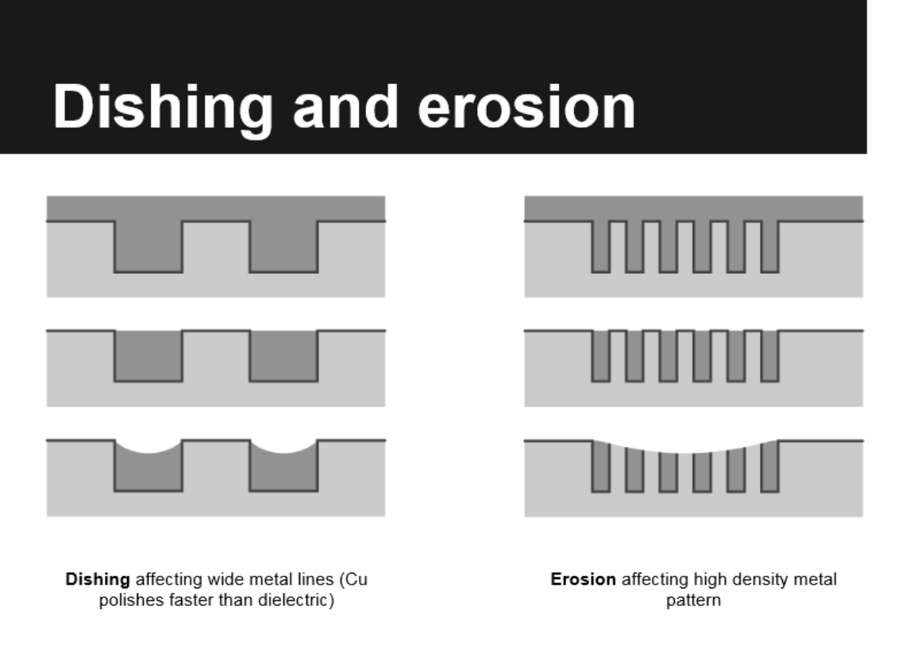

Slide 27
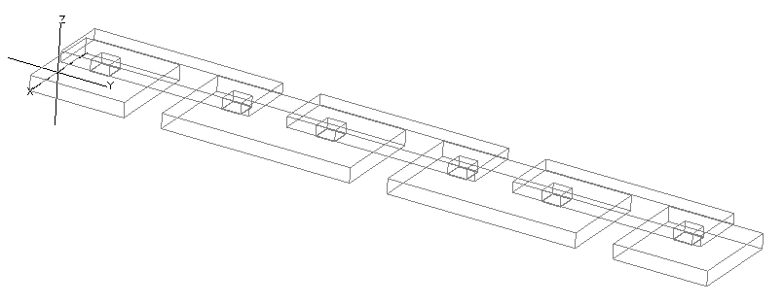
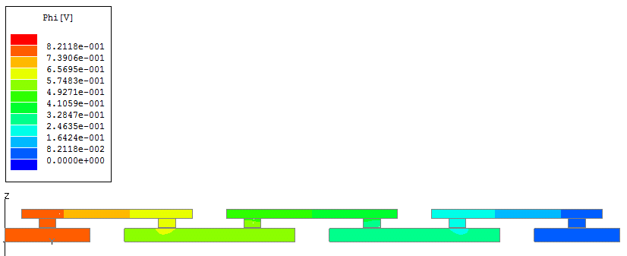
Via Chain Test Structure
M2
V2
1.5um
2.5um
M1

Slide 28
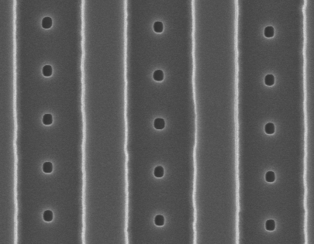
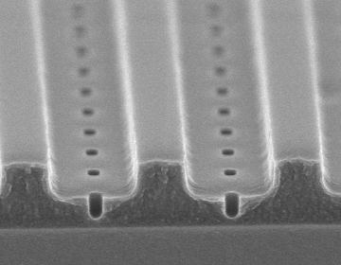
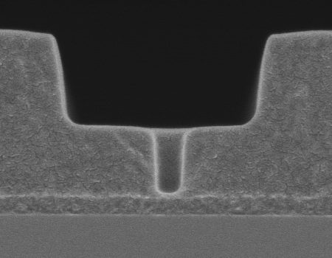
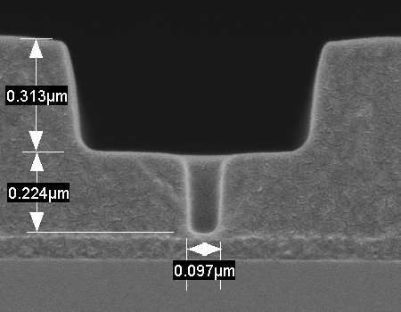
Via Chain Structures
Via chain
M2 by SFIL
M1 by
Photolithography
100nm vias
100nm vias
100nm via

Slide 29
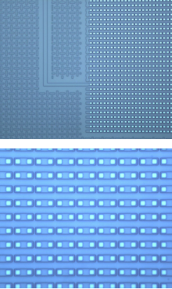
Template
now a commercial product
Via chain test site

Slide 30
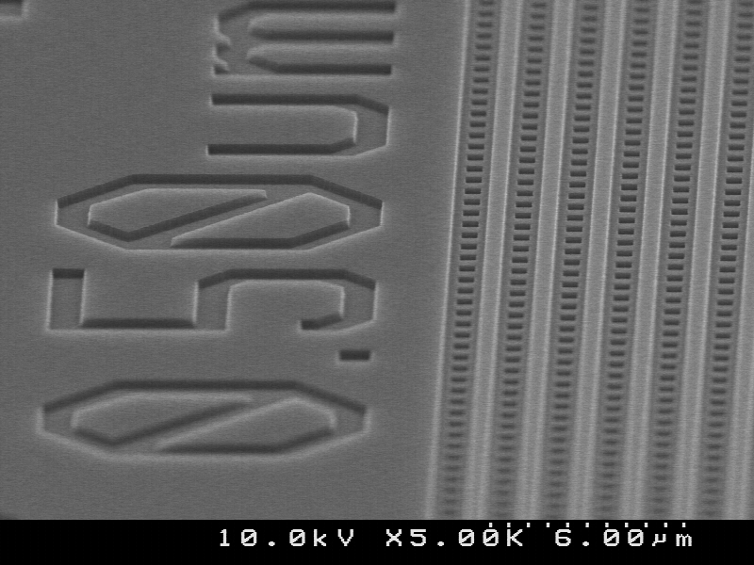
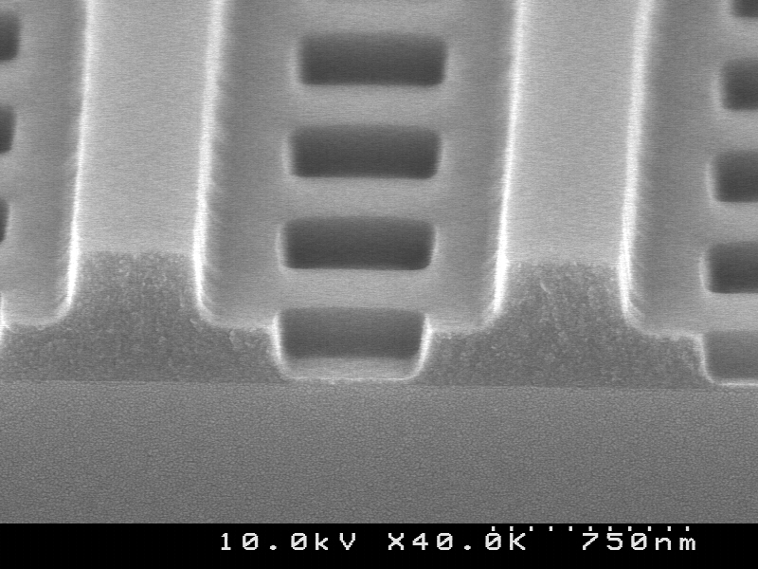
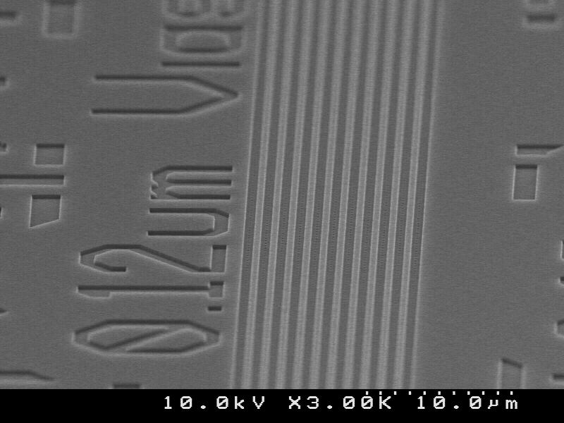
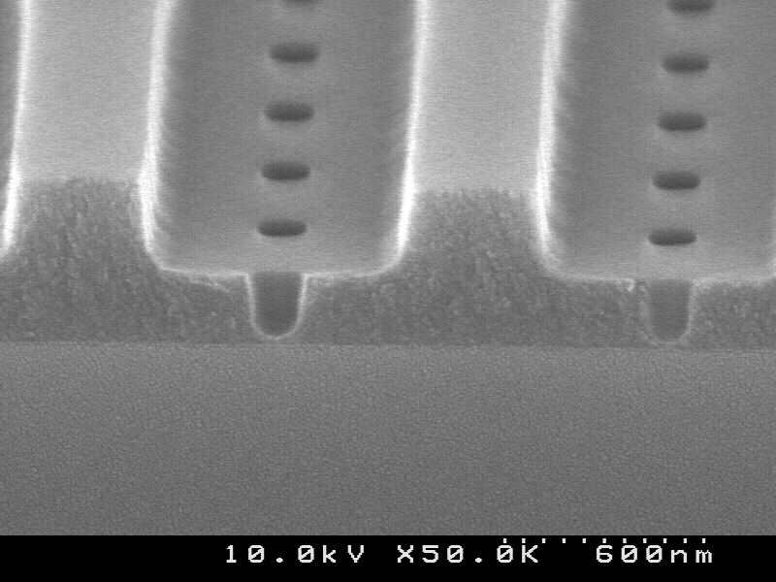
Imprinting

Slide 31
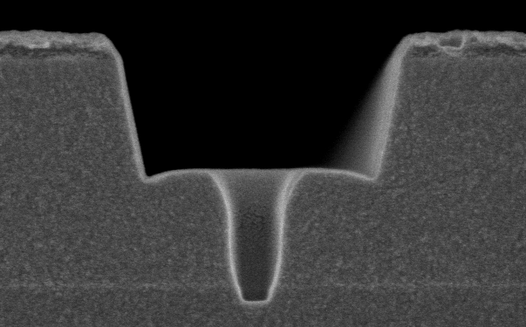
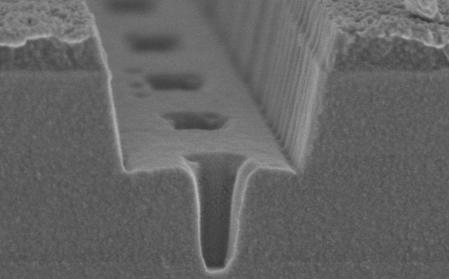
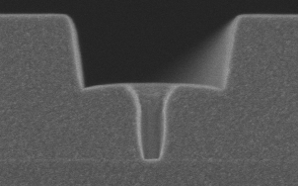
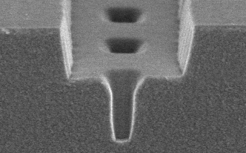
Pattern Transfer Demonstration
Trench
Etch
CF₄/C₄F₈/N ₂
Ash
N₂/H₂
Both Coral® and Black Diamond® were processed

Slide 32
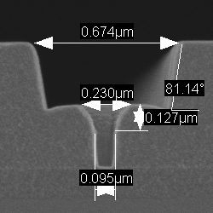
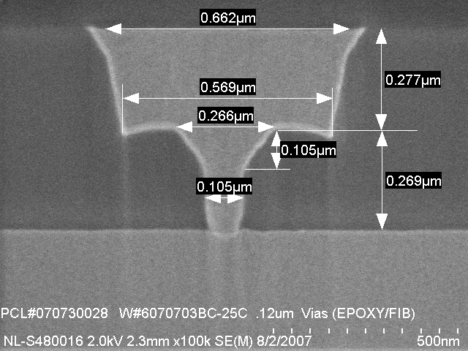
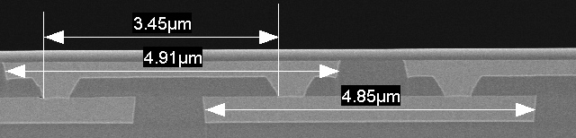
Wiring Level Complete
If this works, it saves more than 100 unit process steps from the manufacturing of a modern microprocessor and provides a saving of 20-50% (per studies by Infineon and SEMATECH)
After etch
After metal
After metal

Slide 33
Wiring Level Complete
After etch
After metal
After metal

Slide 34
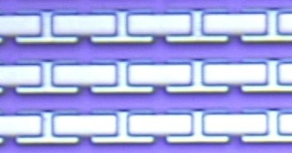
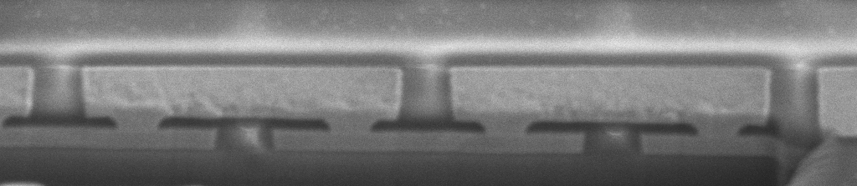
Completed Via Chains
M2
V2
M1
34

Slide 35
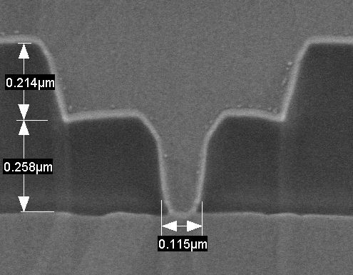
Via Chain – 120 nm 1000 Contacts
Cu (M2)
Ta
Coral
Cu (M1)
Template CD = 120 nm
Final CD = 115 nm
Yield statistics (6 valid and identical chains tested)
  Overall yield of 1000-contact chains with via CD 120 nm (nominal) / 115 nm (final) – 96.83%
  Individual contact yield – 99.9968%

Slide 36
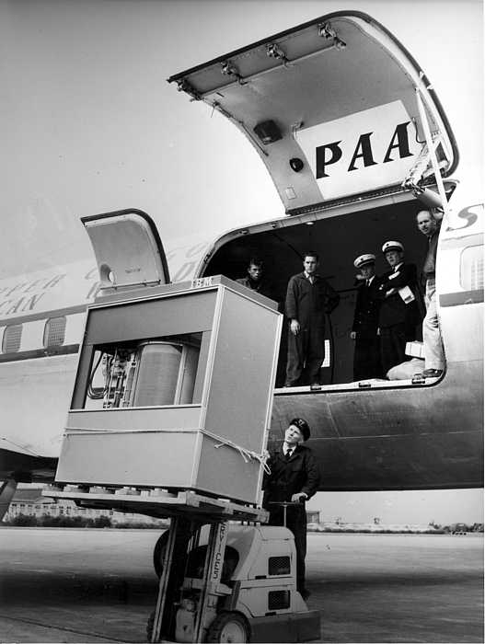
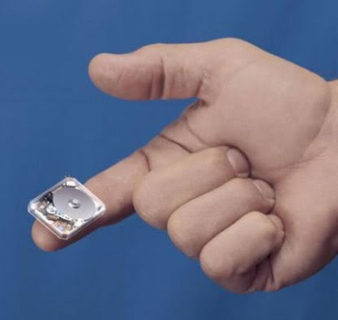
1957 TODAY
IBM’s 5 MB Drive
Toshiba’s 4 GB Drive

Slide 37
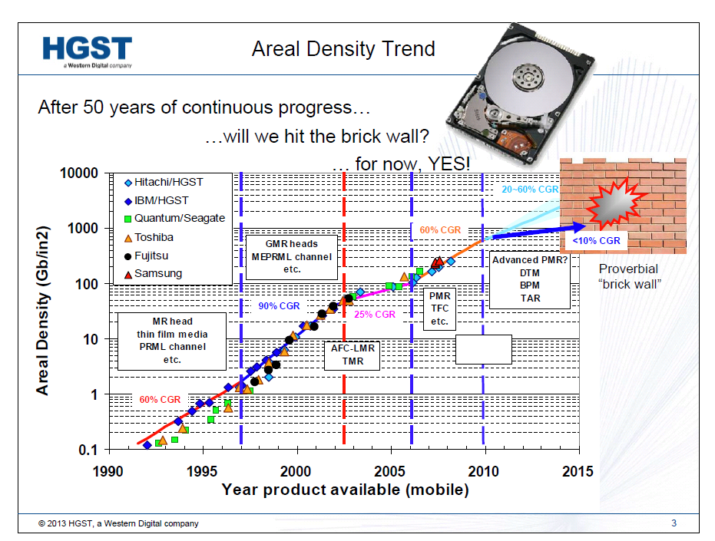

Slide 38
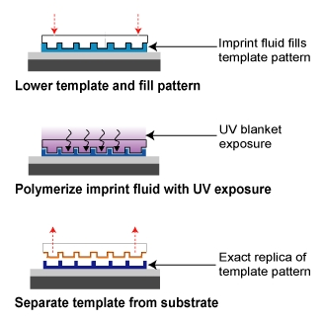
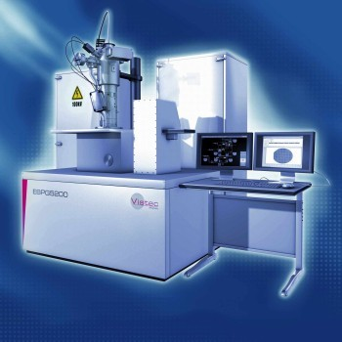
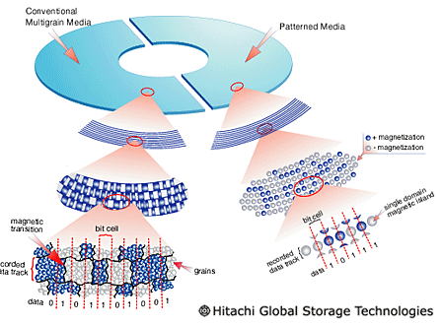
Very Small Features required for New Hard Disk Drives
Electron Beam Lithography
Nanoimprint Lithography
http://www.patrickcarlberg.dk/Lic/Intro%20mm/lith_image2.htm
http://nextbigfuture.com/2009/06/electron-beam-lithography.html
http://www.itmweb.com/bimages/mitechnique.jpg
Lodder, J.C., Journal of Magnetism and Magnetic Materials, 2004. p. 1692-1697.

Slide 39
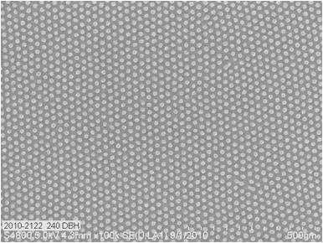
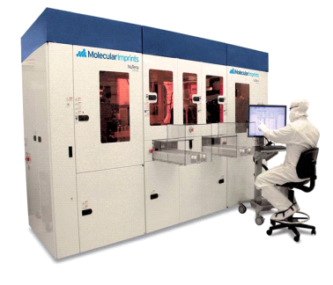
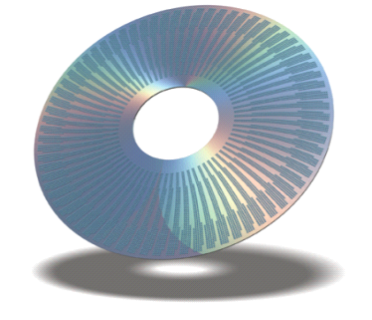


Printing Bit Patterned Media
BPM Disk Imprint
NuTera
TM
HD7000
-
2.5
-
inch Disk
12nm Half Pitch Resist Pillars on Disk
-
From a hole tone template

